Slide 1
Implement a data streaming solution with Azure Stream Analytics
Notes:
Before delivering this presentation, review the associated modules on Microsoft Learn (https://aka.ms/mslearn-azure-stream-analytics) and complete the exercises.
Before starting your delivery, prepare a lab environment for the first demonstration by running the setup script.

Slide 2




Agenda
Get started with Azure Stream Analytics
Ingest streaming data using Azure Stream Analytics and Azure Synapse Analytics
Visualize real-time data with Azure Stream Analytics and Power BI

Slide 3
Get started with Azure Stream Analytics

Slide 4











Introduction to data streams
X: 2022-01-01:00:12
Y: {data}
X: 2022-01-01:00:03
Y: {data}
X: 2022-01-01:00:01
Y: {data}
01
Σ=3
Unbounded data source – records added perpetually
Each data record represents an event at a specific time
Data values can be aggregated over temporal (time-based) windows
Results are typically used to support real-time visualization or ingested into an analytical store for historic analysis
Notes:
Common examples of streaming data include data emitted by Internet-of-things (IoT) devices and social media feeds. The key differentiation between streaming data and batch data is that streams are “boundless” they’re perpetually having new data added. Typically, each record in a stream represents an event at a specific point in time.

Slide 5







Event processing with Azure Stream Analytics
Ingest data from an input
Azure Event Hubs, Azure IoT Hub, or Azure Storage blob container
Process the data by using a query
Select, filter, and aggregate data values.
Write the results to an output
Azure Data Lake Gen 2
Azure SQL Database
Azure Synapse Analytics
Azure Functions
Azure Event Hubs
Microsoft Power BI
Others
Azure Stream Analytics Job
SELECT *
INTO output
FROM input
Input
Output
Query
Notes:
In addition to Azure Stream Analytics jobs (which are standalone perpetual queries hosted in Azure), you can create Azure Stream Analytics clusters – which enable you to define a dedicated tenant for stream processing. See https://learn.microsoft.com/azure/stream-analytics/cluster-overview for more details.

Slide 6
Window functions – Tumbling Window
Contiguous series of fixed-size, non-overlapping temporal windows
SELECT DateAdd(minute,-1,System.TimeStamp) AS WindowStart,
System.TimeStamp() AS WindowEnd,
MAX(Reading) AS MaxReading
INTO
[output]
FROM
[input] TIMESTAMP BY EventProcessedUtcTime
GROUP BY TumblingWindow(minute, 1)
Time: | 3rd Minute |  |  |  |  |  | 2nd Minute |  |  |  |  |  | 1st Minute
Time: | 60 | 50 | 40 | 30 | 20 | 10 | 60 | 50 | 40 | 30 | 20 | 10 | 60 | 50 | 40 | 30 | 20 | 10
Events:
Windows: |  |  |  |  |  |  |  |  |  |  |  |  | MaxReading: 3.1
 |  |  |  |  |  |  | MaxReading: 2.9
 | MaxReading: 3.4
3.1
3.4
3.2
2.8
2.7
2.9
2.6
3.1
3.0
Notes:
Note on the slide that the stream of events occur from right to left (in other words, the most recent event is shown on the left, the first event in the stream is at the right-hand end)

Slide 7
Window functions – Hopping Window
Overlapping windows at fixed intervals
SELECT DateAdd(second,-60,System.TimeStamp) AS WindowStart,
System.TimeStamp() AS WindowEnd,
MAX(Reading) AS MaxReading
INTO
[output]
FROM
[input] TIMESTAMP BY EventProcessedUtcTime
GROUP BY HoppingWindow(second, 60, 30)
Time: | 3rd Minute |  |  |  |  |  | 2nd Minute |  |  |  |  |  | 1st Minute
Time: | 60 | 50 | 40 | 30 | 20 | 10 | 60 | 50 | 40 | 30 | 20 | 10 | 60 | 50 | 40 | 30 | 20 | 10
Events:
Windows: |  |  |  |  |  |  |  |  |  |  |  |  | MaxReading: 3.1
 |  |  |  |  |  |  |  |  |  | MaxReading: 2.6
 |  |  |  |  |  |  | MaxReading: 2.9
 |  |  |  | MaxReading: 3.2
 | MaxReading: 3.4
3.1
3.4
3.2
2.8
2.7
2.9
2.6
3.1
3.0
Notes:
The key point is that hopping windows can overlap, so some events can be counted in more than one window.

Slide 8

Window functions – Sliding Window
All windows of a specified duration in which events occur
SELECT DateAdd(minute,-1,System.TimeStamp) AS WindowStart,
System.TimeStamp() AS WindowEnd,
MAX(Reading) AS MaxReading
INTO
[output]
FROM
[input] TIMESTAMP BY EventProcessedUtcTime
GROUP BY SlidingWindow(minute, 1)
Time: | 3rd Minute |  |  |  |  |  | 2nd Minute |  |  |  |  |  | 1st Minute
Time: | 60 | 50 | 40 | 30 | 20 | 10 | 60 | 50 | 40 | 30 | 20 | 10 | 60 | 50 | 40 | 30 | 20 | 10
Events:
Windows: |  |  |  |  |  |  |  |  |  |  |  |  | MaxReading: 3.1
 |  |  |  |  |  |  |  |  |  |  | MaxReading: 3.1
 |  |  |  |  |  |  | MaxReading: 2.9
 |  |  |  | MaxReading: 2.9
 |  | MaxReading: 3.2
 | MaxReading: 3.2
3.2
2.7
2.9
2.6
3.1
3.0
Notes:
A sliding window is essentially a hopping window where each event initiates a new window.

Slide 9
Window functions – Session Window
Variable length windows in which events occur within a specific timeout
SELECT DateAdd(second,-60,System.TimeStamp) AS WindowStart,
System.TimeStamp() AS WindowEnd,
MAX(Reading) AS MaxReading
INTO
[output]
FROM
[input] TIMESTAMP BY EventProcessedUtcTime
GROUP BY SessionWindow(second, 20, 60)
Time: | 3rd Minute |  |  |  |  |  | 2nd Minute |  |  |  |  |  | 1st Minute
Time: | 60 | 50 | 40 | 30 | 20 | 10 | 60 | 50 | 40 | 30 | 20 | 10 | 60 | 50 | 40 | 30 | 20 | 10
Events:
Windows: |  |  |  |  |  |  |  |  |  |  |  |  |  |  | MaxReading: 3.1
 |  |  |  |  |  | MaxReading: 2.9
 | MaxReading: 3.4
3.1
3.4
2.8
2.7
2.9
2.6
3.1
3.0
Notes:
A session window is initiated by a new event (like a sliding window), but the window lasts as long as events keep occurring within a specified timeout of one another. This means there can be gaps between windows in which no events occurred.

Slide 10

Window functions – Snapshot Window
Windows containing concurrent events with the same timestamp
SELECT System.TimeStamp() AS WindowTime,
MAX(Reading) AS MaxReading
INTO
[output]
FROM
[input] TIMESTAMP BY EventProcessedUtcTime
GROUP BY System.Timestamp()
Time: | 3rd Minute |  |  |  |  |  | 2nd Minute |  |  |  |  |  | 1st Minute
Time: | 60 | 50 | 40 | 30 | 20 | 10 | 60 | 50 | 40 | 30 | 20 | 10 | 60 | 50 | 40 | 30 | 20 | 10
Events:
Windows:
 | MaxReading: 3.4 |  |  |  |  |  | MaxReading: 2.9 |  |  |  | MaxReading: 3.1 |  |  |  | MaxReading: 3.1
3.1
2.9
3.1
3.0
3.4
2.6
3.1
Notes:
Snapshot windows are generated for any point in time where one or more events occur.

Slide 11

Demo: Get started with Azure Stream Analytics
You can try this for yourself later by following the instructions at the link below:
https://aka.ms/mslearn-stream-lab
Notes:
The demonstration will take around 15 minutes.
Tell students that they can try the steps for themselves after class, though they may need to use their own Azure subscription if a hosted environment is not provided.

Slide 12

Knowledge check
You need to process a stream of sensor data, aggregating values over one-minute windows and storing the results in a data lake. Which service should you use?
Azure SQL Database
Azure Cosmos DB
Azure Stream Analytics
You want to aggregate event data by contiguous, fixed-length, non-overlapping temporal intervals. What kind of window should you use?
Sliding
Session
Tumbling
Notes:
Allow students a few minutes to think about the questions, and then use the animated slide to reveal the correct answers.

Slide 13
Ingest streaming data using Azure Stream Analytics and Azure Synapse Analytics

Slide 14


Stream ingestion scenarios Relational data warehouse
Relational data warehouse
Use an Azure Synapse Analytics output
Specify:
An alias for the output
The target Synapse Analytics dedicated SQL pool
The existing table into which the data is to be loaded
Authentication credentials
Query ingested data using SQL in the dedicated SQL pool
Notes:
Loading the results of a streaming job into a table in an Azure Synapse Analytics dedicated SQL pool makes sense when the output of the streaming query is in a structure that can be integrated into a relational data warehouse schema. Since the results of streaming queries typically reflect individual events or aggregated numeric values from multiple events within a time period, the resulting table is generally a fact table.

Slide 15


Stream ingestion scenarios Data Lake
Data Lake
*
Use a Blob storage/ADLS Gen2 output
Specify:
An alias for the output
The target Azure Storage account and container
Authentication credentials
File format
Folder pattern (for example, YYYY/MM/DD)
Query ingested data using the serverless SQL pool or an Apache Spark pool
Notes:
Rather than load the results of a streaming job directly into a data warehouse table, you can write the results to the data lake, defining a partitioning pattern for folder hierarchy where the data will be written. Data Analysts and Data Scientists can then use Spark or serverless SQL pools to explore the data, or you can include the data in a pipeline operation to transform and load it into a data warehouse.

Slide 16

Exercise: Ingest streaming data into Azure Synapse Analytics
Use the hosted lab environment provided, or view the lab instructions at the link below:
https://aka.ms/mslearn-stream-analytics-synapse
Notes:
The exercise will take a minimum of 45 minutes to complete, including 5-10 minutes at the start to set up the environment.
Not all students work at the same pace, so you should allow an hour or more as necessary for your class.
While students are completing the exercise, you can prepare for the next demonstration by running the setup script for that exercise.

Slide 17
Knowledge check
Which type of output should you use to ingest the results of an Azure Stream Analytics job into a dedicated SQL pool table in Azure Synapse Analytics?
Azure Synapse Analytics
Blob storage/ADLS Gen2
Azure Event Hubs
Which type of output should be used to ingest the results of an Azure Stream Analytics job into files in a data lake for analysis in Azure Synapse Analytics?
Azure Synapse Analytics
Blob storage/ADLS Gen2
Azure Event Hubs
Notes:
Allow students a few minutes to think about the questions, and then use the animated slide to reveal the correct answers.

Slide 18
Visualize real-time data with Azure Stream Analytics and Power BI

Slide 19
Azure Stream Analytics and Power BI
Use a Power BI output to send streaming query results to Power BI
Specify:
An alias for the output
The target Power BI workspace
Names of the dataset and table to be created
Authentication information
The query creates a streaming dataset with a single table
Notes:
Microsoft Power BI is primarily used by data analysts to create data models and visualizations. It’s covered in more depth in courses PL-300 (Microsoft Power BI Data Analyst) and DP-500 (Designing and Implementing Enterprise-Scale Analytics Solutions Using Microsoft Azure and Microsoft Power BI). In this scenario, we’re focusing on Power BI as a target for streaming putput in order to generate real-time visualizations.

Slide 20
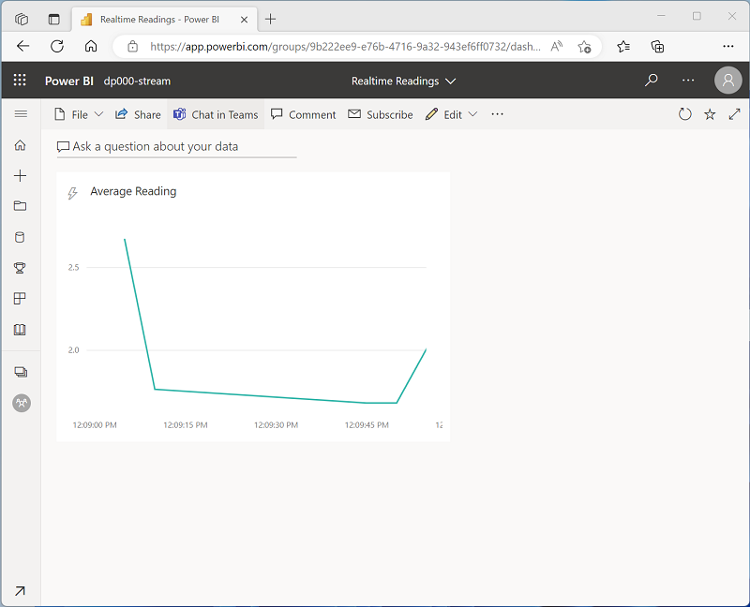
Real-time data visualizations in Power BI
Create a dashboard
Add a tile:
Select the streaming dataset
Configure the desired visualization
View the dashboard
The visualization is updated in real-time as new data arrives in the table
Notes:
Dashboards are automatically refreshed to show new data within a specified period. Older data that is considered “stale” is automatically removed from the real-time dataset so that the dashboard reflects a real-time view of the data. If you need to perform historical analysis of the data by retaining all events, you should use the techniques described in the previous section of this presentation to persist the results of your streaming job in Azure Synapse Analytics.

Slide 21
Demo: Create a real-time data visualization
You can try this for yourself later by following the instructions at the link below:
https://aka.ms/mslearn-stream-powerbi
Notes:
The demonstration will take around 45 minutes.
Tell students that they can try the steps for themselves after class, though they may need to use their own Azure subscription and Power BI tenant if a hosted environment is not provided.

Slide 22
Knowledge check
Which type of Azure Stream Analytics output should you use to support real-time visualizations in Microsoft Power BI?
Azure Synapse Analytics
Azure Event Hubs
Power BI
You want to use an output to write the results of a Stream Analytics query to a table in a dataset in a Power BI workspace. What should you do?
Create only the workspace before creating the output
Create the workspace and dataset before creating the output
Create the workspace, dataset, and table before creating the output
You want to create a visualization that updates dynamically based on a table in a streaming dataset in Power BI. What should you do?
Create a report from the dataset
Create a dashboard with a tile based on the streaming dataset
Export the streaming dataset to Excel and create a report from the Excel workbook
Notes:
Allow students a few minutes to think about the questions, and then use the animated slide to reveal the correct answers.

Slide 23

Further reading
Implement a Data Streaming Solution with Azure Stream Analytics
https://aka.ms/mslearn-azure-stream-analytics
Notes:
Encourage students to review the online material on Microsoft Learn on which this presentation is based.

